Slide 1

Green Pace
Security Policy Presentation
Developer: Matthew R. Leclerc

Slide 2

OVERVIEW: DEFENSE IN DEPTH
Green Pace Secure Development Policy ensures that software development adheres to industry standards.
Implements Defense in Depth, reducing vulnerabilities in code development.
Establishes encryption, authentication, authorization, and secure coding principles.

Slide 3
THREATS MATRIX
Likely SQL Injection Memory Corruption | Priority Hardcoded Credentials Unchecked Buffer Allocation
Low priority Deprecated APIs & Libraries | Unlikely Overly Complex Code Structures
Threats Matrix identifies vulnerabilities in C/C++ development.

Slide 4
10 PRINCIPLES
Validate Input Data
Heed Compiler Warnings
Architect & Design for Security
Keep It Simple
Default Deny
Least Privilege Principle
Sanitize Data Sent to Other Systems
Defense in Depth
Quality Assurance Techniques
Adopt a Secure Coding Standard

Slide 5
CODING STANDARDS
Data Type
Data Value
String Correctness
SQL Injection
Memory Protection
Assertions
Exceptions
Expressions
Containers
Object-Oriented Programming

Slide 6
ENCRYPTION POLICIES
Encryption Policies: Encryption in Flight:
Uses TLS 1.2+, HTTPS.
Encryption at Rest: Full disk encryption, AES-256.

Slide 7
TRIPLE-A POLICIES
Authentication: Multi-Factor Authentication (MFA), Single Sign-On (SSO).
Authorization: Role-Based Access Control (RBAC), Least Privilege.
Accounting: Logging system activities, SIEM monitoring.

Slide 8
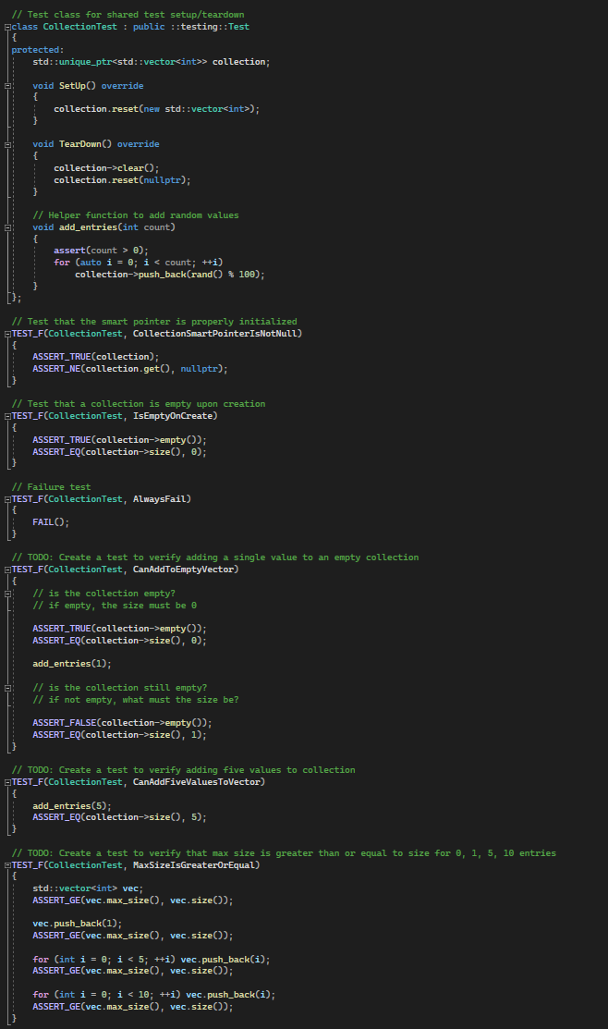
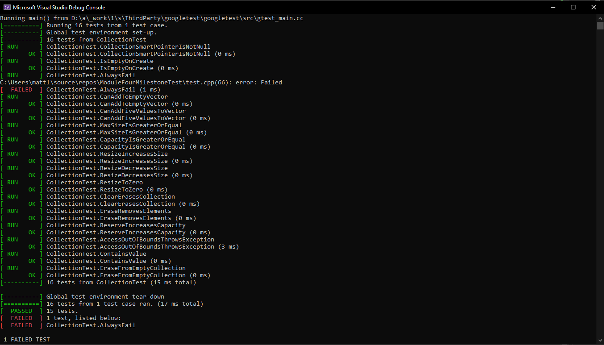
Unit Testing

Slide 9

AUTOMATION SUMMARY

Slide 10
TOOLS (Continued Slide 9)
Security is embedded in CI/CD pipelines.
Automated static and dynamic security analysis.
Use of Coverity, Clang Static Analyzer, CodeSonar.

Slide 11
RISKS AND BENEFITS
Key Risks
Security debt if policies are not followed.
Cost of implementation.
Benefits
Reduces Attack Surface
Regulatory Compliance

Slide 12
RECOMMENDATIONS & CONCLUSION
Gaps Identified
Need for automated enforcement of security policies.
Improve logging mechanisms for tracking access.
Future Standard
Implement Zero Trust Architecture.
Enforce Regular security reviews.

